Slide 1
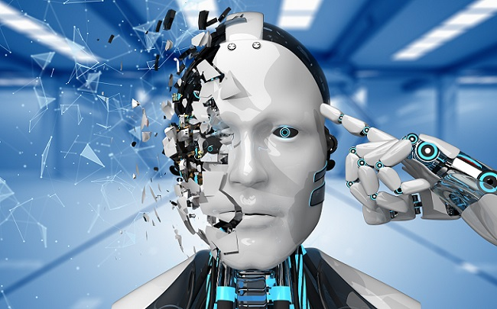

Deep Learning and Application
Unit Assessment
(Coursework Brief)
Dr. Hari Mohan Pandey
Data Science and Artificial Intelligence
School of Computing & Engineering, Bournemouth University
Office: P302, Poole House
https://staffprofiles.bournemouth.ac.uk/display/hpandey
hpandey@bournemouth.ac.uk

Slide 2

Outline
Introduction to Coursework Brief.
Use of Generative AI
About the Tasks
Background Information
Dataset Description
Kaggle Competition
Assessment Requirements
Technical and Report Structure.
Intended Learning Outcomes
Submission Template
Marking Criteria
Office Hours

Slide 3
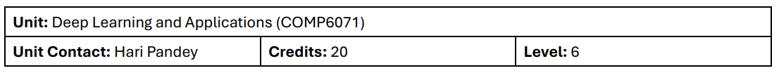
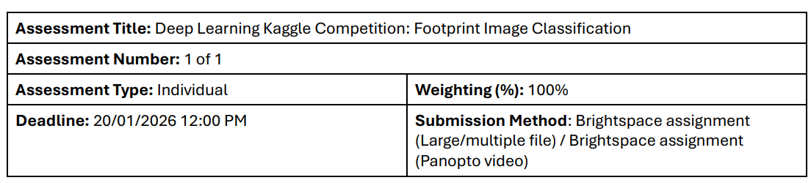
Introduction to Coursework Brief

Slide 4
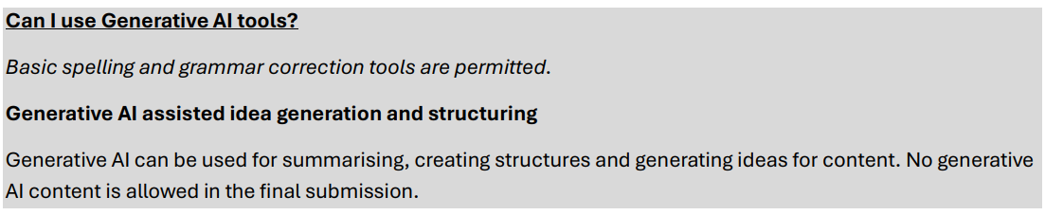
Use of Generative AI Tools

Slide 5
Tasks
This is an individual assignment which addresses all four Intended Learning Outcomes (ILOs) for this unit.
Your task is to design, implement, and evaluate a deep learning-based classifier to solve an image classification problem within a competitive Kaggle environment. You will be required to build a model from scratch to establish a baseline, systematically experiment with a range of techniques to improve performance, and leverage state-of-the-art pre-trained models. The entire project, including all code, analysis, and a comprehensive report, must be submitted as a single, self-contained Jupyter Notebook, accompanied by a short video presentation.

Slide 6
Background
You have been contracted as a Deep Learning Engineer to develop a proof-of-concept system for forensic analysis. The goal is to automatically predict an individual's sex based on images of their footprint. Such a tool could help investigators narrow down the field of potential suspects in a criminal investigation. Your task is to build the most accurate predictive model using modern deep learning techniques.

Slide 7
DATASET
The image dataset for this assignment will be provided via a private Kaggle competition. The training set contains 1,573 footprint images, each labelled with the corresponding sex (0/1). A separate test set of 1,055 images is provided without labels, which you will use to generate predictions for submission.

Slide 8
KAGGLE COMPETITION
To join the Kaggle competition:
  Go to https://www.kaggle.com and create an account.
  Sign up for the competition at: https://www.kaggle.com/t/d9310f0a07e0982afae3e4e669559331
  You can use http://www.kaggle.com/competitions/budl25 to access the competition again at any time.
You will be required to upload a .csv file with your predictions for the test set. A sample submission file will be provided on Kaggle to demonstrate the required format.
You can make a maximum of 5 submissions per day. There are two leaderboards: a public leaderboard based on a portion of the test data, and a private leaderboard based on the remaining data. You can track your progress on the public leaderboard. Your final mark will be based on a combination of your position on the private leaderboard and effort demonstrated via the number, frequency and diversity of your submissions.
The Kaggle competition closes 5 days before the submission deadline to allow you to finalise your writeup.

Slide 9
ASSIGNMENT REQUIREMENTS: Technical Constraints
Framework: All models must be implemented using PyTorch ecosystem. The use of Keras, TensorFlow, or other deep learning frameworks is not permitted. If in doubt, please ask the unit leader.
Environment: Your notebook must be fully reproducible in a standard Google Colab environment. Any external libraries not included in Colab by default must be installable via a pip install command in an early code cell.

Slide 10
ASSIGNMENT REQUIREMENTS: Submission Structure
Your submission must be a single Jupyter Notebook containing all code, narrative, and outputs.
For the detailed submission structure please check “Submission Structure Section” in the Assessment Brief.

Slide 11
Intended Learning Outcomes (ILOs)
Demonstrate an understanding of Machine Learning tasks where Deep Learning solutions are applied.
Demonstrate an understanding of common Deep Learning methods and models and their suitable applications.
Identify, select and apply Machine Learning and Deep Learning methods to solve complex real-world problems using state-of-the-art software tools and libraries.
Analyse and optimise the performance of Deep Learning solutions professionally in appreciation of their ethical, legal and social impacts.

Slide 12
Submission Format
You must submit two items via Brightspace. If any of these items is missing, you will be awarded 0 marks for the whole assignment:
A single Jupyter Notebook (.ipynb) file. This notebook must be self-contained and reproducible. At the top of the notebook, you must clearly state:
  Your Kaggle Username
  Your final score on the Kaggle private leaderboard
  The total number of submissions you made to Kaggle
A 10-minute video presentation (a compact .mp4 file) in which you walk through your Jupyter notebook, explaining your methodology, key experiments, final results, and critical reflections.

Slide 13
Submission Template
A submission template notebook will be provided to help you structure and prepare your report for submission.
Please ensure you use this template to maintain consistency and meet the required formatting guidelines.

Slide 14
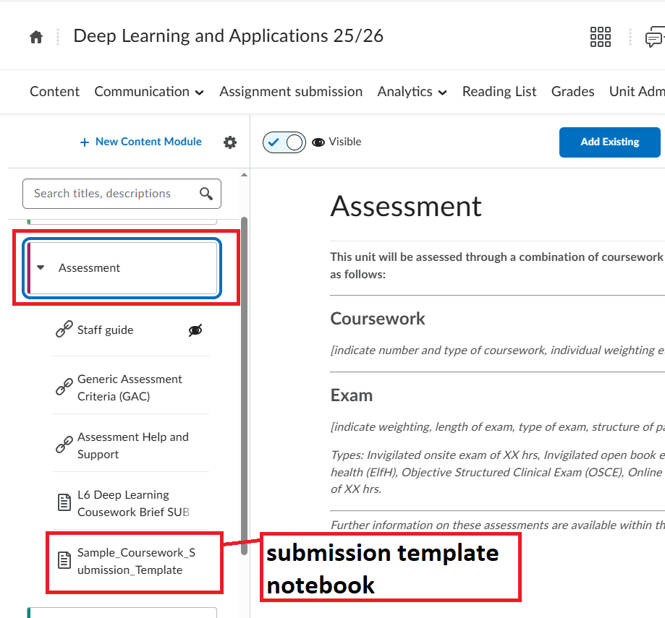
Where to Find the Submission Template?
The submission template notebook will be made available on the unit’s Brightspace page under the Assessment section.

Slide 15
Sample Notebook for Practice
A sample notebook will be provided to help you practice and understand the overall submission process.
You will work on this sample notebook during the Lab session in Week 3.

Slide 16
How will this be assessed?
Element | Criterion | Mark | ILO(s)
Video presentation | Clarity of Explanation & Walkthrough: The quality of the walkthrough of the code, key results, and the ability to articulate project's narrative and findings. | 15% | 2,3,4
Kaggle Performance & Code | Kaggle Performance & Effort: A combination of the final accuracy on the private leaderboard and the number, frequency and diversity of submissions. | 10% | 3,4
 | Code & Notebook Quality: Complexity, correctness, and reproducibility of the PyTorch implementation. | 10% | 3
Analysis and Experimentation | Problem & Baseline Analysis: Justification for using deep learning and a well-reasoned baseline model. | 10% | 1,3
 | State-of-the-Art Architecture Analysis: Quality of research and comparison of pre-trained models. | 10% | 1,2
 | Depth and Rigour of Experiments: Quality of the 10+ experiments, including narrative, analysis, and results. | 20% | 4
Evaluation and Reporting | Final Model Evaluation: Critical evaluation of the best model's performance and insightful discussion of ethical, legal, and social impacts. | 10% | 2,4
 | Application and Interpretation of XAI: Correct application and insightful interpretation of explainability methods. | 10% | 2
 | Report Professionalism & Conclusion: Overall structure, clarity, and quality of the final conclusions. | 5% | 4

Slide 17
Questions about this assessment
You are encouraged to ask questions about the brief as early as possible during timetabled sessions, office hours and electronically via email and Teams chat.

Slide 18
Office Hours
My office hours for this term are as follows:
Tuesday: 2:00 – 3:00 PM
Wednesday: 10:00 – 11:00 AM
Please email me at hpandey@bournemouth.ac.uk in advance to book an appointment before attending.

Slide 19
Thank You!

